Slide 1
BIKE and HQC
Presented by Ray Perlner

Slide 2
BIKE and HQC teams
BIKE1, HQC1, HQC2 – Primary (1) and secondary (2) contacts for BIKE, HQC
New Submitter (Valentin Vasseur) for BIKE – Probably added for BIKE-CCA decoder
New Developer (Jurjen BOS) for HQC
Both | BIKE Only | HQC Only
Nicolas Aragon Slim Bettaieb Loïc Bidoux Olivier Blazy Jean Christophe Deneuville (HQC 2) Philippe Gaborit (HQC 1) Edoardo Persichetti Gilles Zémor | Paolo Barreto Rafael Misoczki (BIKE 1) Nicolas Sendrier Jean Pierre Tillich Valentin Vasseur (New for Round 2) | Carlos Aguilar Melchor Jurjen Bos (Developer, Round 2)

Slide 3
Intro Summary
BIKE and HQC have a lot in common:
  NTRU-like and Ring-LWE-like constructions based on shortness in the Hamming Metric
  Information set decoding is the primary means of Cryptanalysis
  All matrices use quasicyclic structure
Differences
  HQC decodes using a public error correcting code (BCH ⊗ Repetition)
    Only includes a single Ring-LWE-like construction
  BIKE uses a bit-flipping decoder for a hidden QC-MDPC code
    Packages 2 NTRU-like variants (BIKE 1,2) and a Ring-LWE-like variant (BIKE3)
  In Round 1, BIKE had a higher DFR than HQC and targeted IND-CPA security
    Round 2 BIKE retains IND-CPA version, but adds IND-CCA version using a more complicated decoder

Slide 4
BIKE and HQC in context
 | Private Decoder |  | Public Decoder
 | NTRU-like | Ring-LWE-like (Ouroboros) | Ring-LWE-like
Hamming Metric | BIKE-1,2 LEDAcrypt | BIKE-3 | HQC
Rank Metric | ROLLO-1,2 | ROLLO-3 | RQC
Euclidean Metric | NTRU NTRU Prime |  | LAC NewHope

Slide 5
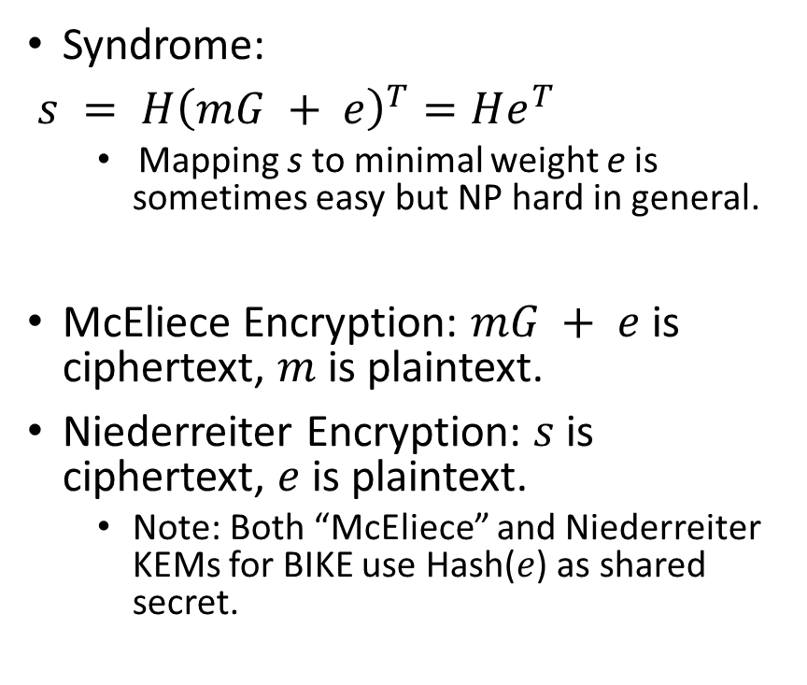
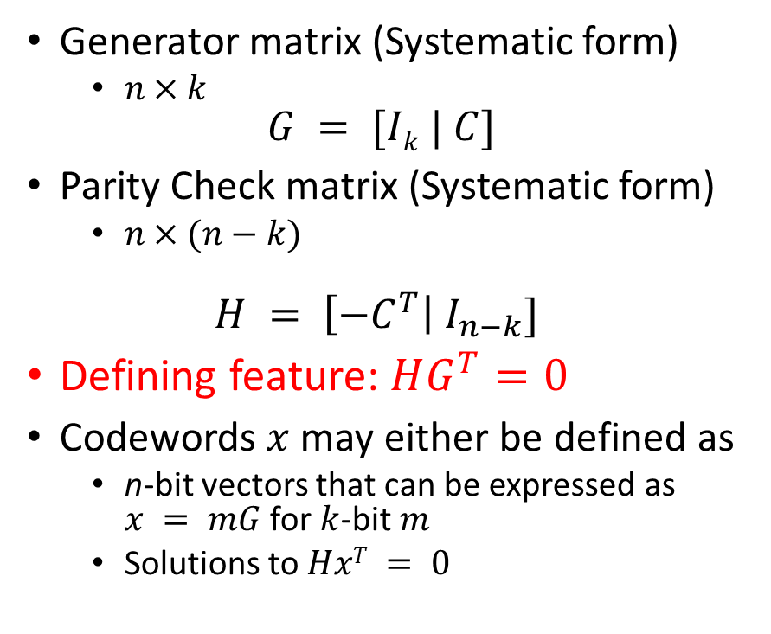
Some Coding Theory
Generator matrix (Systematic form)
  $n×k$
$$G = [Ik | C]$$
Parity Check matrix (Systematic form)
  $n×(n−k)$
$$H = \left[{−C}^{T}\right| I_{n−k}]$$
Defining feature: $HG^{T}=0$
Codewords $x$ may either be defined as
  n-bit vectors that can be expressed as $x = mG$ for $k$-bit $m$
  Solutions to $HxT = 0$
Syndrome:
$s = {H\left(mG + e\right)}^{T}=He^{T}$
  Mapping s to minimal weight e is sometimes easy but NP hard in general.
McEliece Encryption: $mG + e$is ciphertext, $m$ is plaintext.
Niederreiter Encryption: $s$ is ciphertext, $e$ is plaintext.
  Note: Both “McEliece” and Niederreiter KEMs for BIKE use Hash($e$) as shared secret.

Slide 6
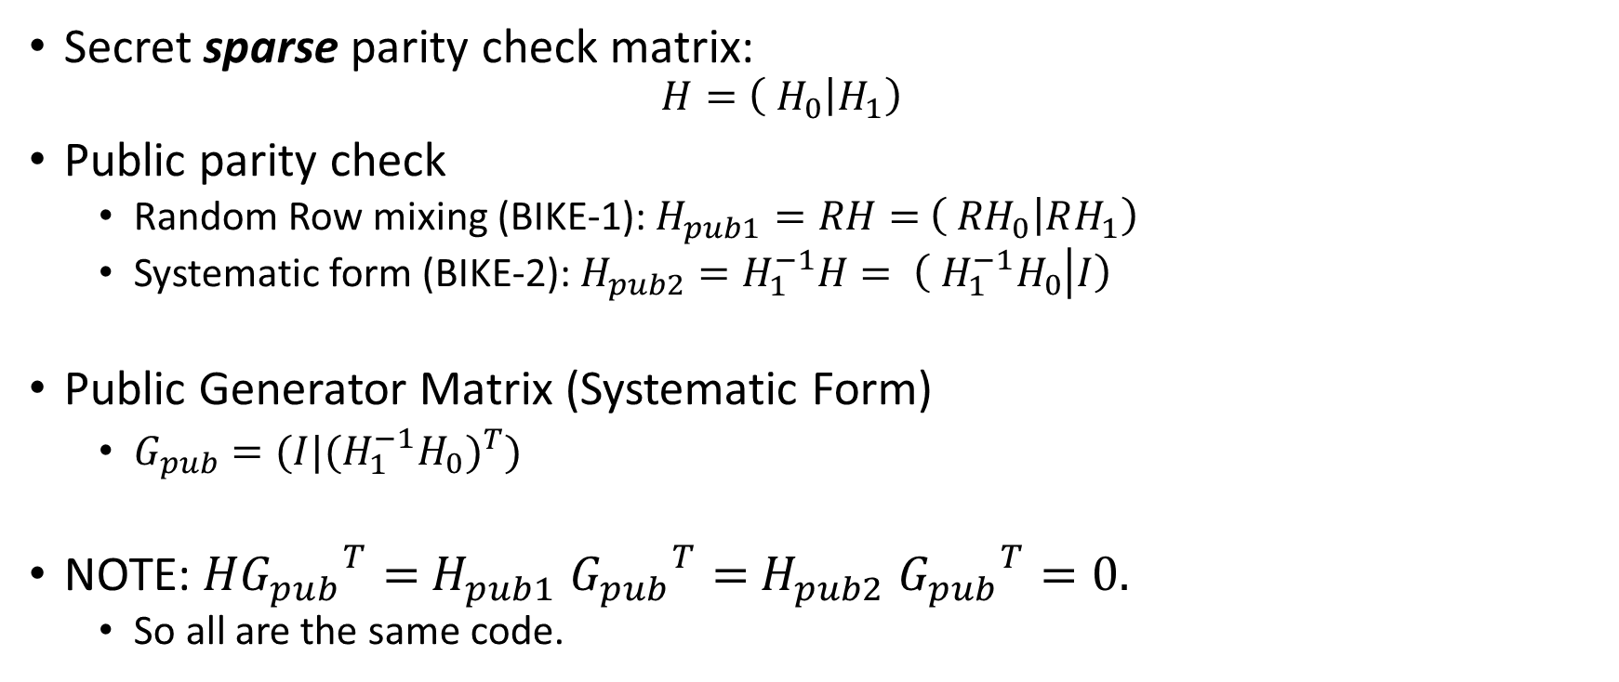
MDPC (Moderate Density Parity Check) Codes
(special case where n = 2k)
Secret sparse parity check matrix:
  $$H=\left( H_{0} | H_{1}\right)$$
Public parity check
  Random Row mixing (BIKE-1): $H_{pub1}=RH=$ $\left( {RH}_{0} | RH_{1}\right)$
  Systematic form (BIKE-2): $H_{pub2}=H_{1}^{−1}H= \left( {H_{1}^{−1}H}_{0} | I\right)$
Public Generator Matrix (Systematic Form)
  $G_{pub}=(I|{{{(H}_{1}^{−1}H}_{0})}^{T})$
NOTE: $H{G_{pub}}^{T}=$ $H_{pub1}$ ${G_{pub}}^{T}=$ $H_{pub2}$ ${G_{pub}}^{T}=0.$
  So all are the same code.

Slide 7

Decoding MDPC codes
(The Bit-Flip Algorithm)
Want to find low weight e such that $He^{T}=s$

Slide 8

Decoding MDPC codes with noisy syndrome
(used in BIKE-3)
Want to find low weight e, e’ such that $He^{T}+ {e′}^{T}=s$
Or equivalently: $\left(\begin{matrix}I & H\end{matrix}\right)\left(\begin{matrix}{e′}^{T} \\ e^{T}\end{matrix}\right)=s$

Slide 9
The last two slides are lies! (sort of)
New decoding algorithms given for round 2
  CPA versions: Actual algorithm is given by “one round bit flipping decoder”
    Note: Submission did not give max running time
  CCA versions: Actual algorithm is given by “backflip decoder”
    Note: Submission did not give max iteration count (I missed this in my completeness review)
  Algorithms are slightly too long to fit on a slide and not conceptually different

Slide 10
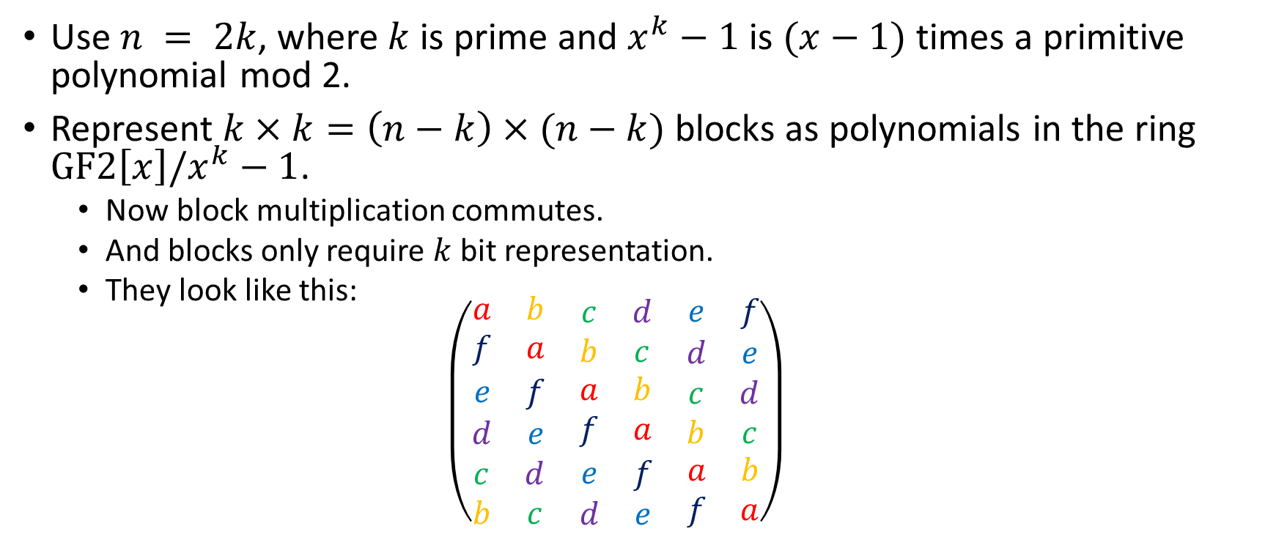
Quasi-Cyclic structure
Use $n = 2k$, where $k$ is prime and $x^{k}−1$ is $(x−1)$times a primitive polynomial mod 2.
Represent $k×k=\left(n−k\right)×(n−k)$ blocks as polynomials in the ring $GF2\left[x\right]/x^{k}−1$.
  Now block multiplication commutes.
  And blocks only require $k$ bit representation.
  They look like this:
  $$\left(\begin{matrix}\begin{matrix}a & b \\ f & a\end{matrix} & \begin{matrix}c & d \\ b & c\end{matrix} & \begin{matrix}e & f \\ d & e\end{matrix} \\ \begin{matrix}e & f \\ d & e\end{matrix} & \begin{matrix}a & b \\ f & a\end{matrix} & \begin{matrix}c & d \\ b & c\end{matrix} \\ \begin{matrix}c & d \\ b & c\end{matrix} & \begin{matrix}e & f \\ d & e\end{matrix} & \begin{matrix}a & b \\ f & a\end{matrix}\end{matrix}\right)$$

Slide 11
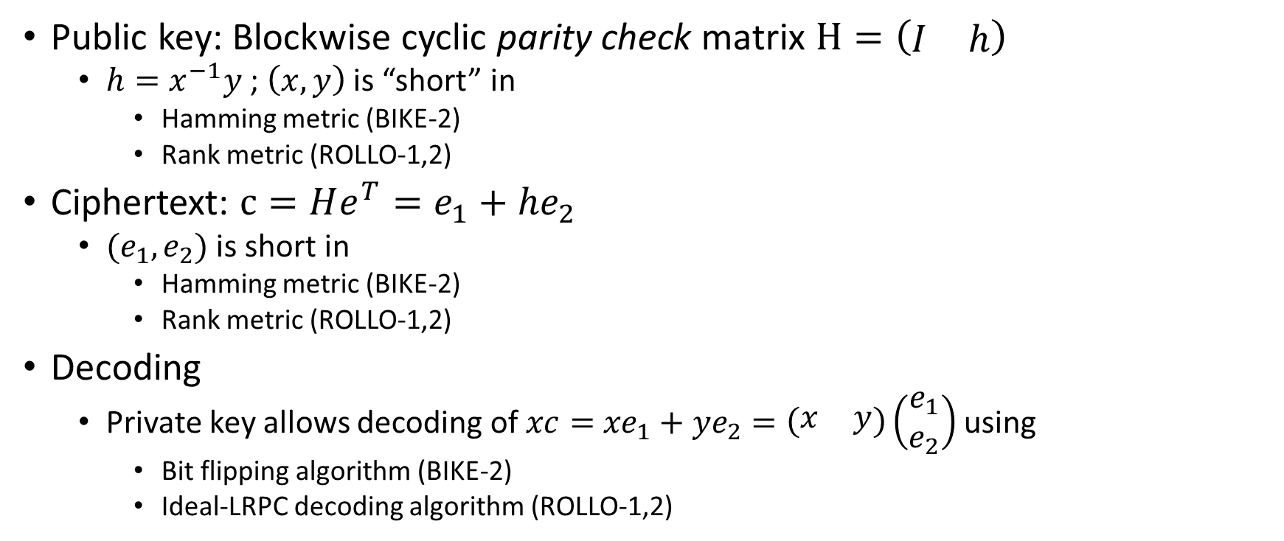
BIKE-2 construction
(Niederreiter)
Public key: Blockwise cyclic parity check matrix $H=\left(\begin{matrix}I & h\end{matrix}\right)$
  $h=x^{−1}y$ ; $\left(x,y\right)$ is “short” in
    Hamming metric (BIKE-2)
    Rank metric (ROLLO-1,2)
Ciphertext: $c=He^{T}=e_{1}+{he}_{2}$
  $(e_{1},e_{2})$ is short in
    Hamming metric (BIKE-2)
    Rank metric (ROLLO-1,2)
Decoding
  Private key allows decoding of $xc=$ ${xe}_{1}+{ye}_{2}=\left(\begin{matrix}x & y\end{matrix}\right)\left(\begin{matrix}e_{1} \\ e_{2}\end{matrix}\right)$ using
    Bit flipping algorithm (BIKE-2)
    Ideal-LRPC decoding algorithm (ROLLO-1,2)

Slide 12
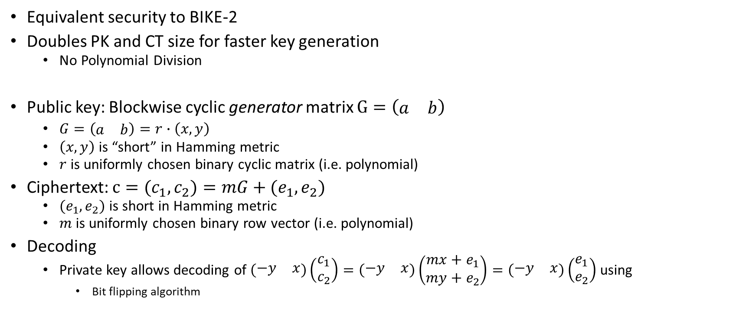
BIKE-1 construction
(McEliece)
Equivalent security to BIKE-2
Doubles PK and CT size for faster key generation
  No Polynomial Division
Public key: Blockwise cyclic generator matrix $G=\left(\begin{matrix}a & b\end{matrix}\right)$
  $G=\left(\begin{matrix}a & b\end{matrix}\right)=r∙\left(x,y\right)$
  $\left(x,y\right)$is “short” in Hamming metric
  $r$ is uniformly chosen binary cyclic matrix (i.e. polynomial)
Ciphertext: $c=(c_{1},c_{2})=mG+(e_{1},e_{2})$
  $(e_{1},e_{2})$ is short in Hamming metric
  $m$ is uniformly chosen binary row vector (i.e. polynomial)
Decoding
  Private key allows decoding of $\left(\begin{matrix}−y & x\end{matrix}\right)\left(\begin{matrix}c_{1} \\ c_{2}\end{matrix}\right)=\left(\begin{matrix}−y & x\end{matrix}\right)\left(\begin{matrix}{mx+e}_{1} \\ my+e_{2}\end{matrix}\right)=\left(\begin{matrix}−y & x\end{matrix}\right)\left(\begin{matrix}e_{1} \\ e_{2}\end{matrix}\right)$ using
    Bit flipping algorithm

Slide 13
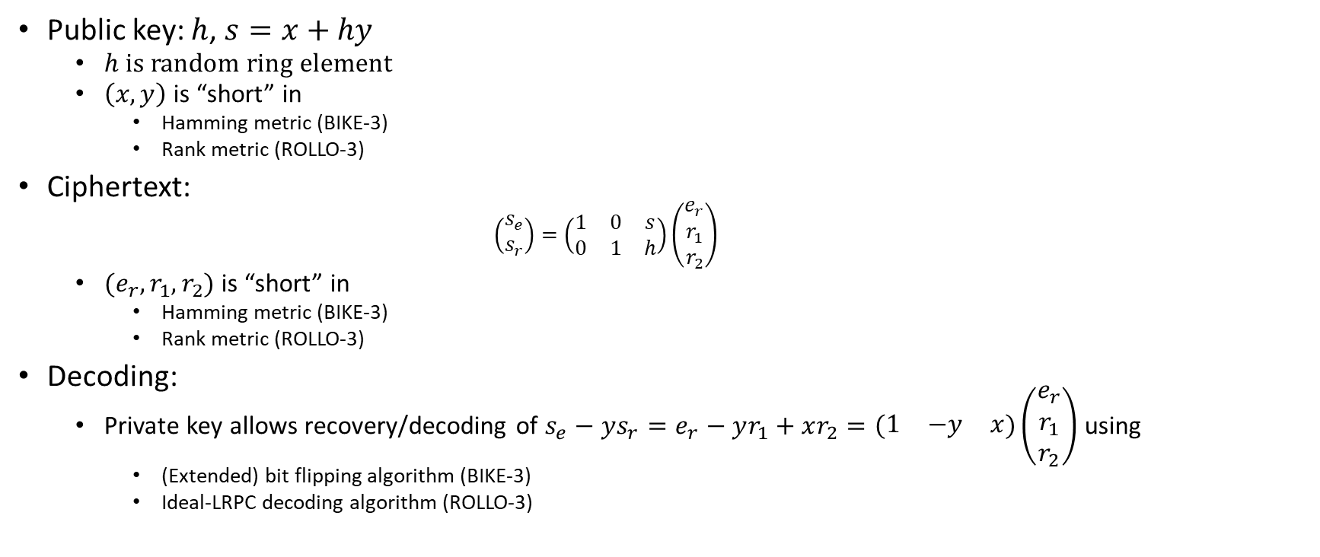
BIKE-3 construction
(Ouroboros)
Public key: $h$, $s=x+hy$
  $h$ is random ring element
  $\left(x,y\right)$ is “short” in
    Hamming metric (BIKE-3)
    Rank metric (ROLLO-3)
Ciphertext:
    $$\left(\begin{matrix}s_{e} \\ s_{r}\end{matrix}\right)=\left(\begin{matrix}1 & 0 & s \\ 0 & 1 & h\end{matrix}\right)\left(\begin{matrix}e_{r} \\ r_{1} \\ r_{2}\end{matrix}\right)$$
  $(e_{r},r_{1},r_{2})$ is “short” in
    Hamming metric (BIKE-3)
    Rank metric (ROLLO-3)
Decoding:
  Private key allows recovery/decoding of $s_{e}−ys_{r}=e_{r}−yr_{1}+xr_{2}=\left(\begin{matrix}1 & −y & x\end{matrix}\right)\left(\begin{matrix}e_{r} \\ r_{1} \\ r_{2}\end{matrix}\right)$ using
    (Extended) bit flipping algorithm (BIKE-3)
    Ideal-LRPC decoding algorithm (ROLLO-3)

Slide 14
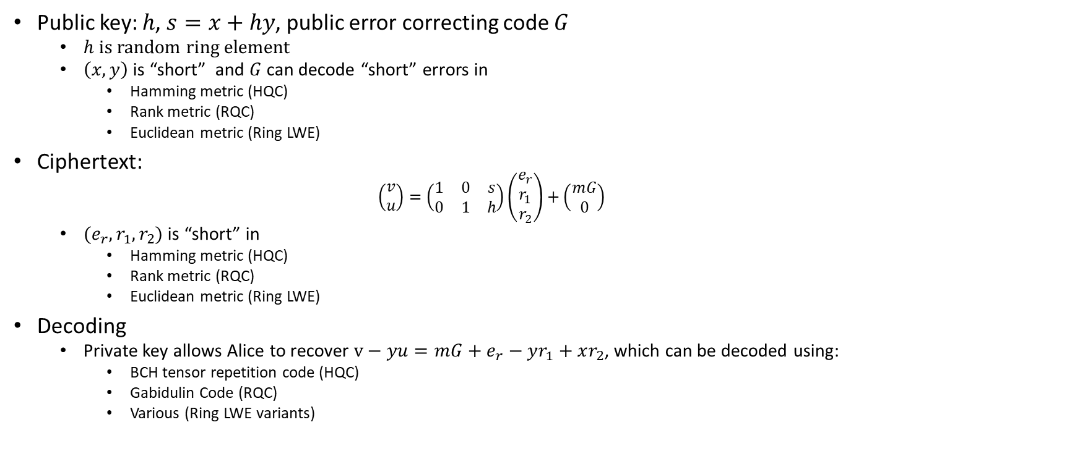
HQC Construction
Public key: $h$, $s=x+hy$, public error correcting code $G$
  $h$ is random ring element
  $\left(x,y\right)$ is “short” and $G$ can decode “short” errors in
    Hamming metric (HQC)
    Rank metric (RQC)
    Euclidean metric (Ring LWE)
Ciphertext:
    $$\left(\begin{matrix}v \\ u\end{matrix}\right)=\left(\begin{matrix}1 & 0 & s \\ 0 & 1 & h\end{matrix}\right)\left(\begin{matrix}e_{r} \\ r_{1} \\ r_{2}\end{matrix}\right)+\left(\begin{matrix}mG \\ 0\end{matrix}\right)$$
  $(e_{r},r_{1},r_{2})$ is “short” in
    Hamming metric (HQC)
    Rank metric (RQC)
    Euclidean metric (Ring LWE)
Decoding
  Private key allows Alice to recover $v−yu={mG+e}_{r}−yr_{1}+xr_{2}$, which can be decoded using:
    BCH tensor repetition code (HQC)
    Gabidulin Code (RQC)
    Various (Ring LWE variants)

Slide 15
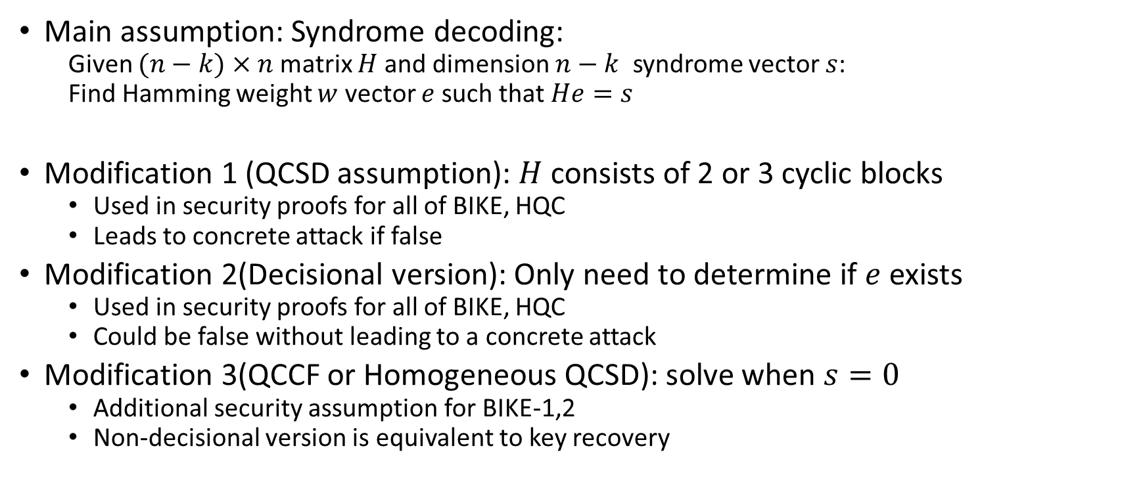
Security assumptions
Main assumption: Syndrome decoding:
  Given $(n−k)×n$ matrix $H$ and dimension $n−k$ syndrome vector $s$:
  Find Hamming weight $w$ vector $e$ such that $He=s$
Modification 1 (QCSD assumption): $H$ consists of 2 or 3 cyclic blocks
  Used in security proofs for all of BIKE, HQC
  Leads to concrete attack if false
Modification 2(Decisional version): Only need to determine if $e$ exists
  Used in security proofs for all of BIKE, HQC
  Could be false without leading to a concrete attack
Modification 3(QCCF or Homogeneous QCSD): solve when $s=0$
  Additional security assumption for BIKE-1,2
  Non-decisional version is equivalent to key recovery

Slide 16
BIKE CCA conversion
(Uses implicit rejection)
CPA:
CCA:

Slide 17
Argument for CCA decryption failure rate
Proof error rate for simplified decoder falls exponentially as t decreases for fixed n, k, w based on (probably false) assumption:
Empirical tests show error rate of actual decoder falls exponentially where it can be tested
Extrapolation of the trend suggests the stated decryption failure rate

Slide 18
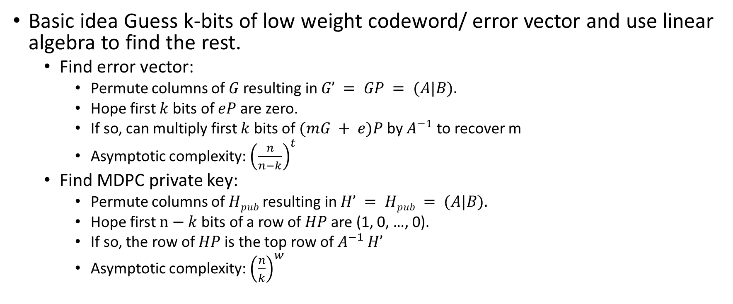
Known attacks: Information Set Decoding
Basic idea Guess k-bits of low weight codeword/ error vector and use linear algebra to find the rest.
  Find error vector:
    Permute columns of $G$ resulting in $G’ = GP = (A|B).$
    Hope first $k$ bits of $eP$ are zero.
    If so, can multiply first $k$ bits of $(mG + e)P$by $A^{−1}$ to recover m
    Asymptotic complexity: ${\left(\frac{n}{n−k}\right)}^{t}$
  Find MDPC private key:
    Permute columns of $Hpub$ resulting in $H’ = Hpub = (A|B).$
    Hope first $n−k$ bits of a row of $HP$ are (1, 0, …, 0).
    If so, the row of $HP$ is the top row of $A^{−1}$ $H’$
    Asymptotic complexity: ${\left(\frac{n}{k}\right)}^{w}$

Slide 19
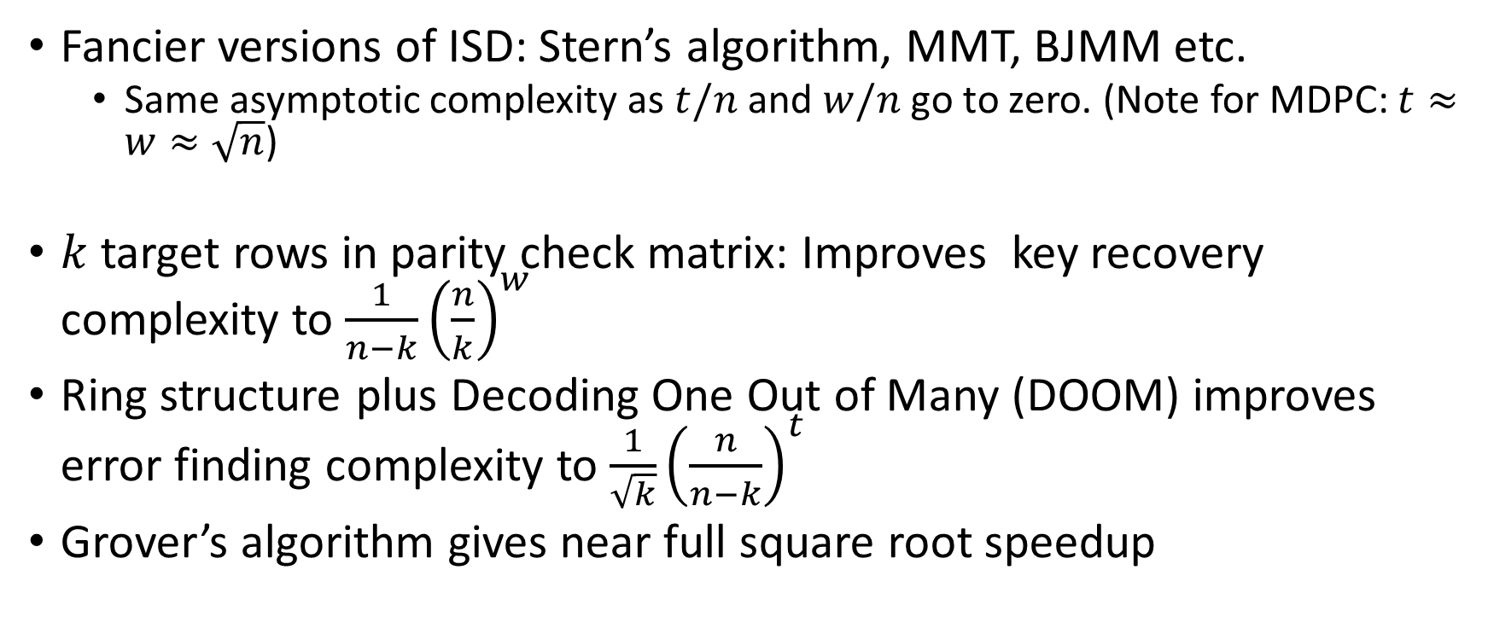
Known attacks: Information Set Decoding
Fancier versions of ISD: Stern’s algorithm, MMT, BJMM etc.
  Same asymptotic complexity as $t/n$ and $w/n$ go to zero. (Note for MDPC: $t≈w≈\sqrt{n}$)
$k$ target rows in parity check matrix: Improves key recovery complexity to $\frac{1}{n−k}{\left(\frac{n}{k}\right)}^{w}$
Ring structure plus Decoding One Out of Many (DOOM) improves error finding complexity to $\frac{1}{\sqrt{k}}{\left(\frac{n}{n−k}\right)}^{t}$
Grover’s algorithm gives near full square root speedup

Slide 20
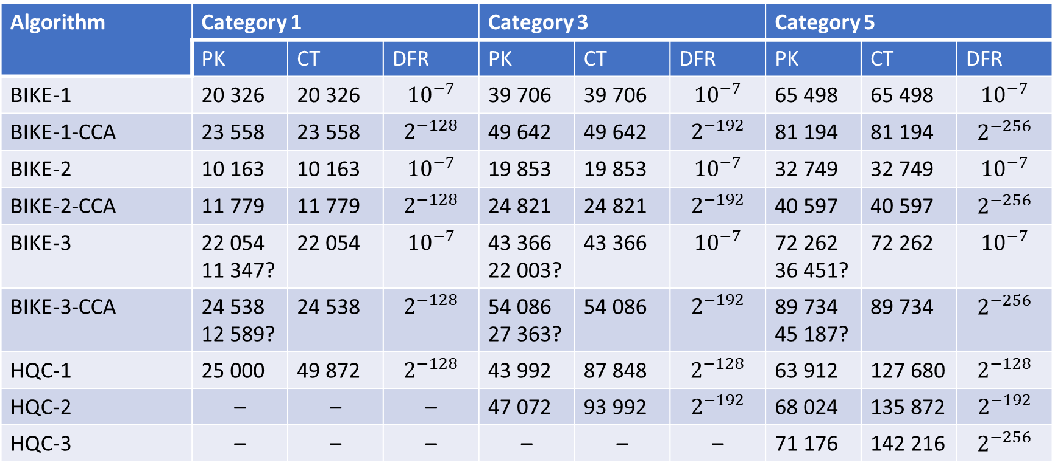
Key sizes (bits) and DFR
Algorithm | Category 1 |  |  | Category 3 |  |  | Category 5
 | PK | CT | DFR | PK | CT | DFR | PK | CT | DFR
BIKE-1 | 20 326 | 20 326 | $${10}^{−7}$$ | 39 706 | 39 706 | $${10}^{−7}$$ | 65 498 | 65 498 | $${10}^{−7}$$
BIKE-1-CCA | 23 558 | 23 558 | $$2^{−128}$$ | 49 642 | 49 642 | $$2^{−192}$$ | 81 194 | 81 194 | $$2^{−256}$$
BIKE-2 | 10 163 | 10 163 | $${10}^{−7}$$ | 19 853 | 19 853 | $${10}^{−7}$$ | 32 749 | 32 749 | $${10}^{−7}$$
BIKE-2-CCA | 11 779 | 11 779 | $$2^{−128}$$ | 24 821 | 24 821 | $$2^{−192}$$ | 40 597 | 40 597 | $$2^{−256}$$
BIKE-3 | 22 054 11 347? | 22 054 | $${10}^{−7}$$ | 43 366 22 003? | 43 366 | $${10}^{−7}$$ | 72 262 36 451? | 72 262 | $${10}^{−7}$$
BIKE-3-CCA | 24 538 12 589? | 24 538 | $$2^{−128}$$ | 54 086 27 363? | 54 086 | $$2^{−192}$$ | 89 734 45 187? | 89 734 | $$2^{−256}$$
HQC-1 | 25 000 | 49 872 | $$2^{−128}$$ | 43 992 | 87 848 | $$2^{−128}$$ | 63 912 | 127 680 | $$2^{−128}$$
HQC-2 | – | – | – | 47 072 | 93 992 | $$2^{−192}$$ | 68 024 | 135 872 | $$2^{−192}$$
HQC-3 | – | – | – | – | – | – | 71 176 | 142 216 | $$2^{−256}$$

Slide 21
Performance
(Reference Implementation – Megacycles)
Algorithm | Category 1 |  |  | Category 3 |  |  | Category 5
 | KeyGen | Enc | Dec | KeyGen | Enc | Dec | Keygen | Enc | Dec
BIKE-1 | 0.73 | 0.69 | 2.90 | 1.71 | 1.85 | 7.67 | 2.99 | 3.02 | 17.48
BIKE-1-CCA | 0.97 | 0.92 | 6.62 | 2.72 | 2.62 | 16.25 | 6.08 | 5.81 | 35.17
BIKE-2 | 6.38 | 0.28 | 2.67 | 22.21 | 0.71 | 7.11 | 58.81 | 1.20 | 16.39
BIKE-2-CCA | 8.09 | 0.48 | 5.82 | 32.06 | 1.31 | 13.84 | 67.74 | 2.98 | 29.47
BIKE-3 | 0.43 | 0.58 | 3.44 | 1.10 | 1.46 | 7.73 | 2.30 | 3.26 | 18.05
BIKE-3-CCA | 0.60 | 0.94 | 7.04 | 1.74 | 2.89 | 16.93 | 3.86 | 6.73 | 36.50
HQC-1 | 0.39 | 0.68 | 1.13 | 0.68 | 1.13 | 1.78 | 0.98 | 1.65 | 2.45
HQC-2 | – | – | – | 0.72 | 1.21 | 1.84 | 1.04 | 1.79 | 2.61
HQC-3 | – | – | – | – | – | – | 1.08 | 1.84 | 2.67

Slide 22
Performance summary
BIKE 2:
  Smaller bandwidth than everything else (factor of 2 improvement in CT size)
  Key generation is most expensive step (6-67 megacycles)
Other BIKE variants
  Larger bandwidth
  Key generation is cheap
  Decapsulation is most expensive step (3-37 megacycles)
    Substantial (factor of 2) cost for CCA security
HQC
  Much larger bandwidth (Factor of 2 worse than BIKE 3)
  All operations are cheap
  Very little additional cost for decreasing DFR

Slide 23

BIKE-2 Batch Key Generation
Assumes polynomial inversion is more expensive than polynomial multiplication
Generate polynomials $x, y, z …$
Compute ${tmp}^{−1}={(x∙y∙z∙…)}^{−1}$
To get e.g. $x^{−1}$ compute $x^{−1}=$ ${tmp}^{−1}$ $∙y∙z∙…$.

Slide 24
BIKE Constant-Time Decoding Cost
(Additional Implementation)
Data only given for BIKE-1, BIKE-2 (how much cost for CCA versions?)

Slide 25
Important questions
Are CCA claims for round 2 BIKE correct?
Do security assumptions matter?
  Ouroboros-R and HQC just assume Decisional (with parity) QCSD
  BIKE1,2 assume (decisional with parity) QCCF in addition to QCSD
How many millions of cycles do you need to save to justify sending an extra 10000 bits?
Can we (or the submitters) narrow down the options somewhat?

Slide 26
Overall advantages/limitations
BIKE/HQC vs (structured) lattices:
  Key sizes comparable to (but not quite as good as) lattices
  Unlike lattices no search/decision or worst/average case reduction
  Complexity of known attacks (ISD) on codes is easier to quantify and stabler than for lattices
    Asymptotic complexity hasn’t changed much since 1962!
BIKE/HQC vs Goppa codes
  Fewer avenues for attack – for BIKE/HQC key and message recovery attacks look (pretty much) the same
    and the same as message recovery for Goppa McEliece
  Key size reduction using rings appears safe for BIKE/HQC
    Not so much for Goppa codes – BIGQUAKE survived round 1 cryptanalysis, but didn’t get that much key size reduction, and the attacks used to set its parameters are quite new
  Goppa codes do have better ciphertext size though

Slide 27
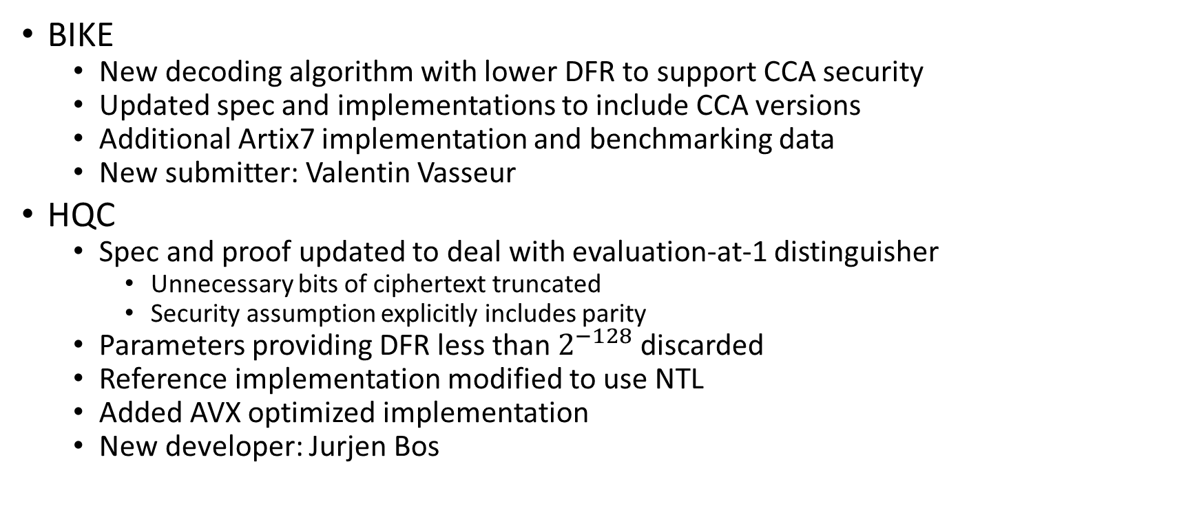
Round 2 changes
BIKE
  New decoding algorithm with lower DFR to support CCA security
  Updated spec and implementations to include CCA versions
  Additional Artix7 implementation and benchmarking data
  New submitter: Valentin Vasseur
HQC
  Spec and proof updated to deal with evaluation-at-1 distinguisher
    Unnecessary bits of ciphertext truncated
    Security assumption explicitly includes parity
  Parameters providing DFR less than $2^{−128}$ discarded
  Reference implementation modified to use NTL
  Added AVX optimized implementation
  New developer: Jurjen Bos

